Slide 1

Mini Project Report On Online Review System Subject-: Web Technologies
Developed by:
Jayesh Chavan
Ashutosh Bhujbal
Vaibhav Dholam
Under the guidance of
Ms. Snehal Mumbaikar

Slide 2
Abstract
Reviews are an essential feedback for any products, and feedback is the best approach in case you are really concerned about the user experience of your products. Reviews tell us about how the product is, what flaws are there in the product and helps the manufacturer the overcome about these flaws in future updates and products. Also it helps people to know about how this product is and it will affect and benefit them while using them.
Thus, keeping in mind all these things, we have developed an Online Review System for electronic products.

Slide 3
Problem statement
The current Online Review System has all the products of different brands Worldwide and user can view them and see other people reviews in them and can add their own review too. To add their own review, they need to
to first sign in and then login within the system and then give review to the product they want. The basic idea is that as all the product from different
brands are here together, they are view any product and can review them, unlike visiting different sites and reviewing them separately on different brand websites.

Slide 4
Analysis
Let’s take the case of Samsung Company. They have their own review system for their products. Similarly Canon Company to have their online review website where reviews are taken from their users. For all these, user needs to login to their particular website and review them about the flaws of their product.

Slide 5
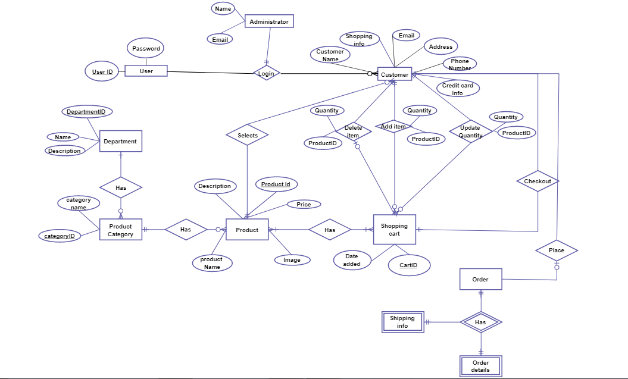
Design

Slide 6
Implementation
HTML
CSS
PHP
JAVASCRIPT
BOOTSTRAP
JQUERY
XML

Slide 7
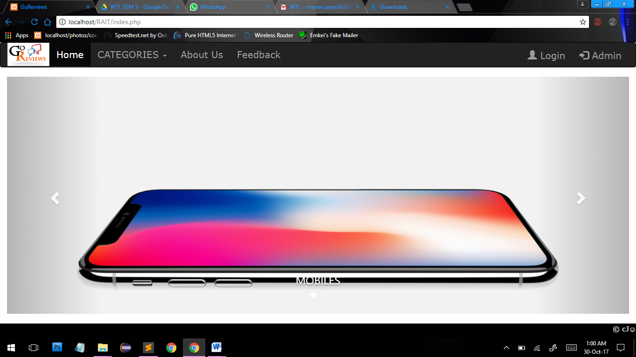
HOMEPAGE

Slide 8
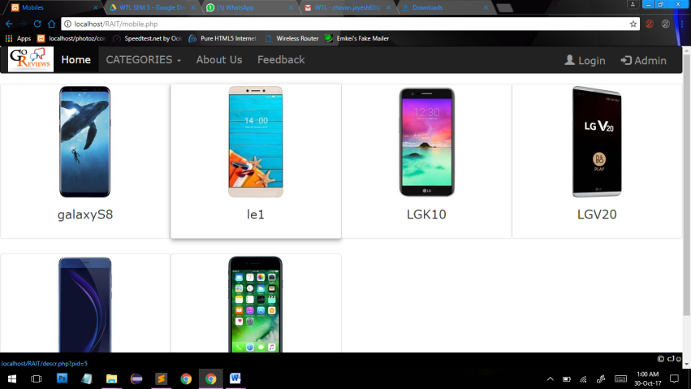
PRODUCT PAGE

Slide 9
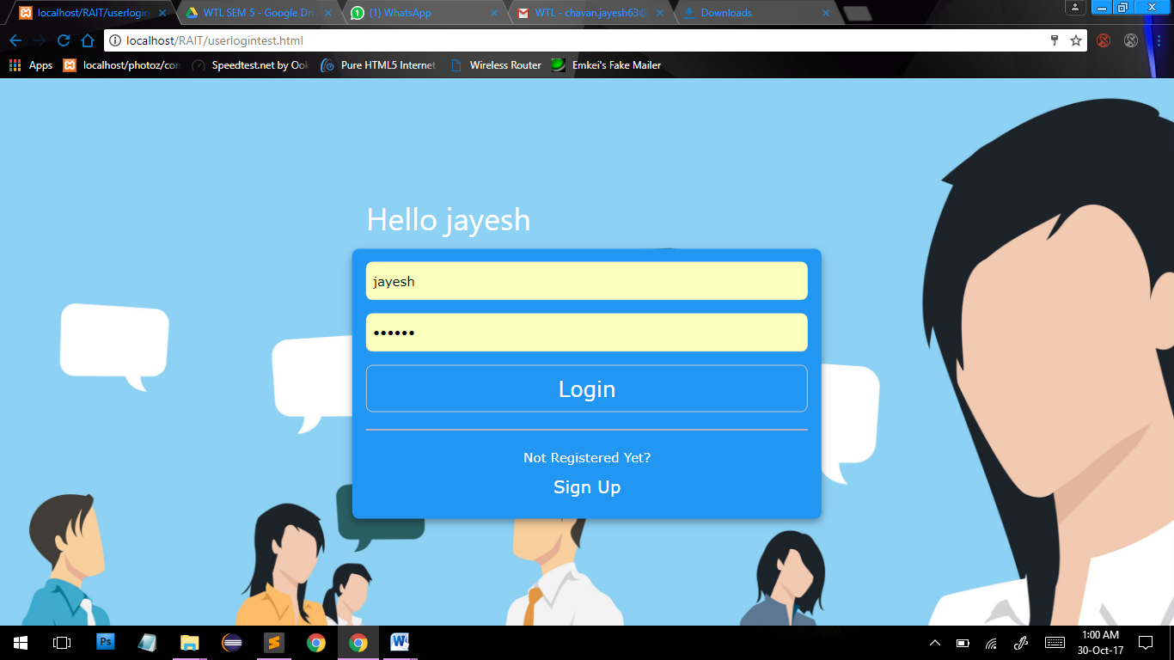
USER LOGIN

Slide 10
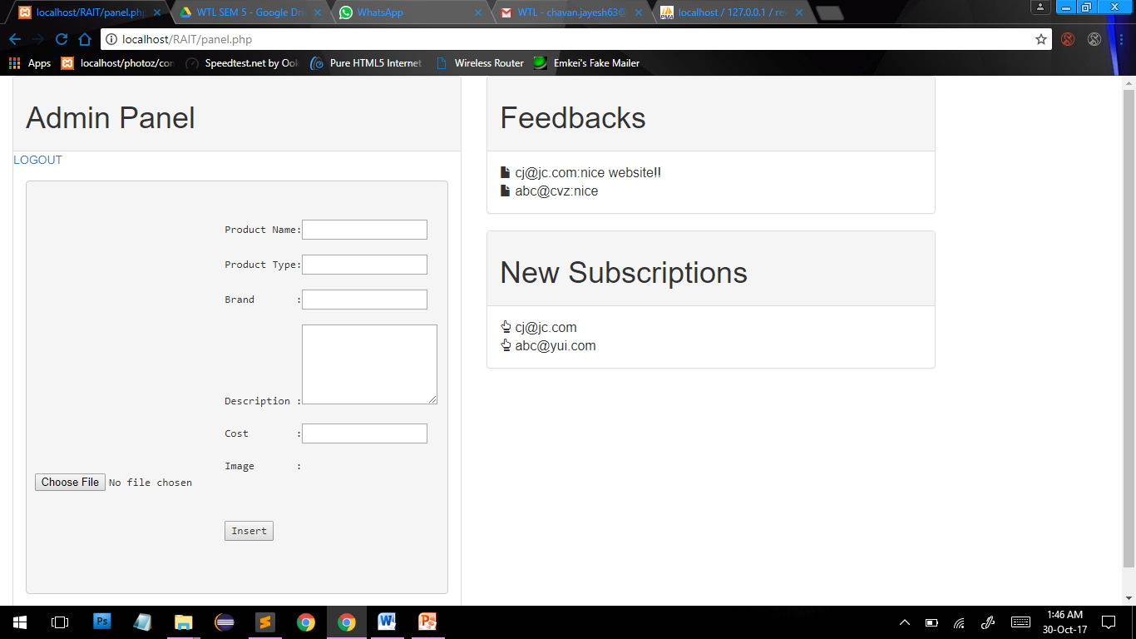
ADMIN PANEL

Slide 11
CONCLUSION
Finally, we would like to say that a good feedback is the one which is transparent and is able to narrow down the communication rift between the users as much as possible and our web application is aimed towards achieving just that. Our web application is therefore a tool that is light weight, scalable and easily accessible and convenient for the users to use. The goal of the system is to design and implement a reviewing solution system that is scalable in terms of functionality, performance and worldwide application.

Slide 12
THANK YOU!!!

